Slide 1
Memory Organization – Computer Organization and Architecture.
Shriram K Vasudevan
Must Know Topic – Pay attn. please

Slide 2

Let us learn about Cache
What is Cache?
Going by Google Dictionary – Cache is a French word. It means hidden.
Coming to the COA analogy, we have a safe place to store things and it is called the cache.
In the example Library scenario – Desk is the cache.
We had books from the shelf to the desk, which is a safe place and it accommodates books.
Let us learn about this a bit detailed.

Slide 3
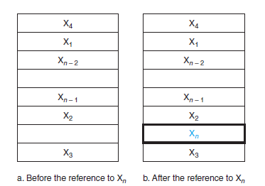
Contd.,
Let us have a simple cache – Before and after the data request process.
Assume, the data is not there initially in the cache. (First time, it would be so)
Before the request, the cache contains a collection of recent references X1, X2, . . . , Xn – 1, and the processor requests a word Xn that is not in the cache.
This request results in a miss, and the word Xn is brought from memory into cache.

Slide 4
Contd.,
Lets answer couple of questions:
Do we have a method to find if the data item is in the cache?
If it is there, How do we zero in it?
The questions are definitely related and hence the answers would also be.
Well, let us understand this:
If each word (data) can go in one place (I mean exactly one place, one location) then, it is straight forward to the find the presence in the cache.
Next, how do you assign a location in the cache for the word in memory? (I mean, how do you give a slot to the word in the memory in cache?)
Can we use the address of the word in memory to do this?
If this done, then we can name it as “Direct Mapped” approach. Each memory location is mapped directly to one location in the cache.
This is very simple and straight.

Slide 5
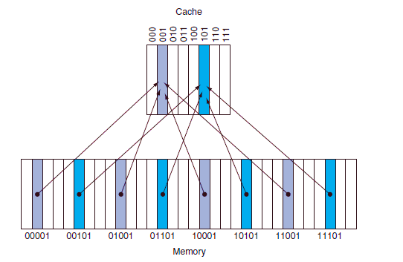
Contd.,
The picture shown in the left is taken as a reference for direct mapping.
Addresses in the memory (from 00001 to 11101) are mapped to (000 to 101) in the cache. This is called direct mapping.
Yes, this is easier to understand.
See this point. Though 000 to 111 are there in cache, we map to 000 to 101 only. (Again, this is not so technical)

Slide 6
Contd.,
Now, there is a challenge.
Each cache location shall contain contents of many memory locations (See the left, 001 has many arrows coming in) how do we know if the data in the cache is the one that we are looking forward to ???
Challenging!
Means, how do we know if the word we search for is inside the cache or not?
Well, we will make it a bit complex now. We will add something called tag. The will carry the address information which can help in identifying the words in the cache appropriately. Means, it helps in understanding if the word inside cache is the one we look for.

Slide 7
Contd.,
Now comes the next question.
How would the tag look like?
For example, (See RHS) we need only to have the upper 2 of the 5 address bits in the tag, since the lower 3-bit index field of the address selects the block.

Slide 8
Contd.,
There is a problem/Challenge – We need to identify if a cache block has no valid information.
Add the valid bit!
Simple. This valid bit will indicate if the entry has a valid address.
If the bit is not set, there cannot be a match for this block.

Slide 9
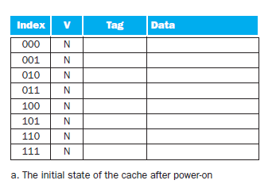
An example is handy! Isn't it ?
The cache is initially empty, with all valid bits (V entry in cache) turned off (N).

Slide 10
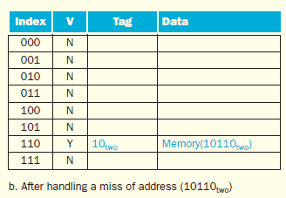
Attempt -1: The processor requests the following address: 10110two
The cache is initially empty, with all valid bits (V entry in cache) turned off (N). The processor requests the following addresses: 10110two(miss), 11010two (miss), 10110two (hit), 11010two (hit), 10000two (miss), 00011two (miss), 10000two (hit), and 10010two (miss).

Slide 11
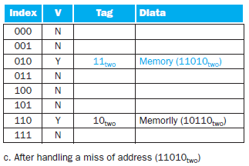
Attempt -2: The processor requests the following address: 11010two (miss)
The cache is initially empty, with all valid bits (V entry in cache) turned off (N). The processor requests the following addresses: 10110two(miss), 11010two (miss), 10110two (hit), 11010two (hit), 10000two (miss), 00011two (miss), 10000two (hit), and 10010two (miss).

Slide 12
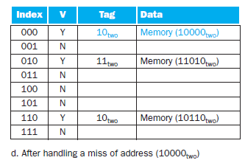
Attempt -3: The processor requests the following address: 10110two (hit)
The processor requests the following addresses: 10110two
(miss), 11010two (miss), 10110two (hit), 11010two (hit), 10000two (miss), 00011two (miss), 10000two (hit), and 10010two (miss).

Slide 13
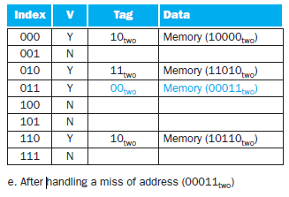
Attempt - 4
The processor requests the following addresses: 10110two
(miss), 11010two (miss), 10110two (hit), 11010two (hit), 10000two (miss), 00011two (miss), 10000two (hit), and 10010two (miss).

Slide 14
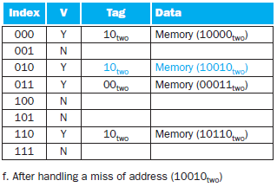
Attempt - 5
When address 10010two (18) is referenced, the entry for address 11010two (26) must be replaced, and a reference to 11010two will cause a subsequent miss
Understand the way tag is used.
The processor requests the following addresses: 10110two
(miss), 11010two (miss), 10110two (hit), 11010two (hit), 10000two (miss), 00011two (miss), 10000two (hit), and 10010two (miss).

Slide 15
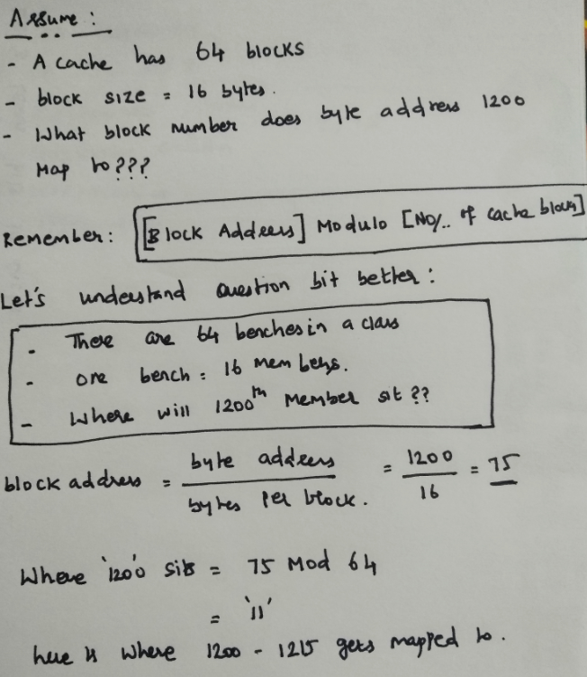
Some math…

Slide 16
Handling cache miss … (Its complicated)
You know by now, what is a cache miss!
When the requested content is not in the cache, the request cannot be handled as the data is not available.
Now, when there is a hit, the action is all trivial. Means, the things will go as planned.
If there is a miss, the process is going to be slightly different as the flow is to be changed to handle the miss.
The cache miss handling is done with the processor control unit and with a separate controller that initiates the memory access and refills the cache.
This miss needs processing to be done and this creates some delay. It is similar to the pipeline stall (remember??) which forced us to save the content in pipelining registers.
For a cache miss, we can stall the entire processor, essentially freezing the contents of the temporary and programmer-visible registers, while we wait for memory.
In contrast, pipeline stalls, are more complex because we must continue executing some instructions while we stall others.

Slide 17
Contd.,
A request for data from the cache that cannot be filled because the data is not present in the cache.
The steps to be taken on an instruction cache miss:
Send the original PC value (current PC – 4) to the memory.
Instruct main memory to perform a read and wait for the memory to complete its access.
Write the cache entry, putting the data from memory in the data portion of the entry, writing the upper bits of the address (from the ALU) into the tag field, and turning the valid bit on.
Restart the instruction execution at the first step, which will refetch the instruction, this time finding it in the cache.

Slide 18
Cache and main memory Inconsistency
Cache and main memory are said to be inconsistent when a data is written only in cache without changing memory. (You agree right??) Techniques to counter it are listed below:
(a) write-through: A scheme in which writes always update both the cache and the memory, ensuring that data is always consistent between the two writes
(b) write buffer stores the data while it is waiting to be written to memory. After writing the data into the cache and into the write buffer, the processor can continue execution. When a write to main memory completes, the entry in the write buffer is freed. If the write buffer is full when the processor reaches a write, the processor must stall until there is an empty position in the write buffer.
(c) In a write-back scheme, when a write occurs, the new value is written only to the block in the cache. The modified block is written to the lower level of the hierarchy when it is replaced. Write-back scheme is, however, more complex to implement than write-through.

Slide 19
Reducing Cache Misses by More Flexible Placement of Blocks
We have learnt the direct mapping techniques in the past!
Let’s learn a bit more than that now.
Fully Associative and Set Associative – Let’s learn them in parallel.

Slide 20
Fully Associative Approach.
In this scheme,
a block can be placed in any location in the cache. (Flexible)
But, here comes a complexity.
In this approach, all the entries in the cache must be searched because a block can be placed in any one.
Comparators will come into the picture here. A comparator is needed for each cache entry and is an expensive affair.
So, this is complex for a relatively larger cache.

Slide 21
Set associative approach
This is an intermediary approach.
Not as complicated as the fully associative approach.
There are a fixed number of locations (at least two) where each block can be placed;
It has the features and both the previous techniques.
Here, a block is directly mapped into a set, and then all the blocks in the set are searched for a match.

Slide 22
Formula.
direct-mapped cache, the position of a memory block is given by
(Block number) modulo (Number of cache blocks)
set-associative cache, the set containing a memory block is given by
(Block number) modulo (Number of sets in the cache)

Slide 23
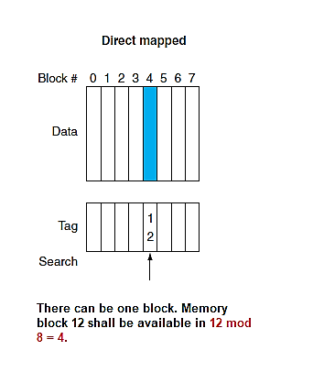
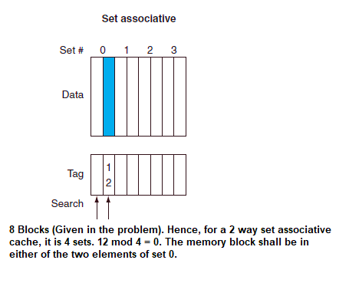
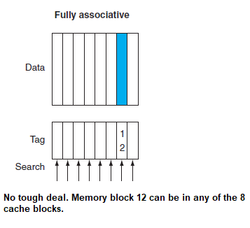
A simple example…

Slide 24
Measuring and Improving Cache Performance
We explore two different techniques for improving cache performance.
One focuses on reducing the miss rate by reducing the probability that two different memory blocks will contend for the same cache location.
The second technique reduces the miss penalty by adding an additional level to the hierarchy.
This technique, called multilevel caching, first appeared in high-end computers and now available even in “Dabba” computers!

Slide 25
Contd.,
CPU time can be divided into the clock cycles that the CPU spends executing the program and the clock cycles that the CPU spends waiting for the memory system.
Normally, we assume that the costs of cache accesses that are hits are part of the normal CPU execution cycles.
Thus,
CPU time = (CPU execution clock cycles + Memory-stall clock cycles) * Clock cycle time
The memory-stall clock cycles come primarily from cache misses, and we make that assumption here.

Slide 26

Contd.,
Memory-stall clock cycles can be defined as the sum of the stall cycles coming from reads plus those coming from writes:
The read-stall cycles can be defined in terms of the number of read accesses per program, the miss penalty in clock cycles for a read, and the read miss rate:
Memory-stall clock cycles = Read-stall cycles + Write-stall cycles
The read-stall cycles can be defined in terms of the number of read accesses per program, the miss penalty in clock cycles for a read, and the read miss rate:

Slide 27

Contd.,
Writes are more complicated. For a write-through scheme, we have two sources of stalls:
write misses, which usually require that we fetch the block before continuing the write.
write buffer stalls, which occur when the write buffer is full when a write occurs.
Thus, the cycles stalled for writes equals the sum of these two:

Slide 28
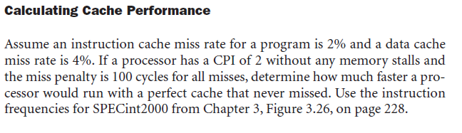
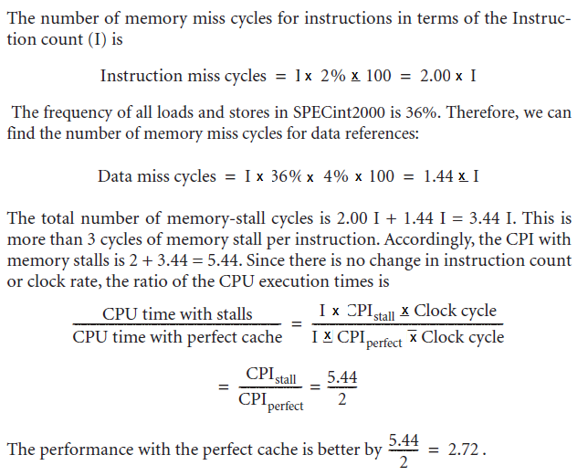
Contd.,

Slide 29
thanks
Shriram K Vasudevan

